Slide 1
80286 Microprocessor

Slide 2
80286 Basic Features
The 80286 microprocessor is an advanced version of the 8086 microprocessor that is designed for multiuser and multitasking environments
The 80286 addresses 16 M Byte of physical memory and 1G Bytes of virtual memory by using its memory-management system

Slide 3
80286 Basic Features
The 80286 is basically an 8086 that is optimized to execute instructions in fewer clocking periods than the 8086
Like the 80186, the 80286 doesn’t incorporate internal peripherals; instead it contains a memory management unit (MMU)
The 80286 operates in both the real and protected modes

Slide 4
80286 Basic Features
In the real mode, the 80286 addresses a 1MByte memory address space and is virtually identical to 8086
In the protected mode, the 80286 addresses a 16MByte memory space
The clock is provided by the 82284 clock generator
The system control signals are provided by the 82288 system bus controller
The 80286 contains the same instructions except for a handful of additional instructions that control the memory-management init

Slide 5
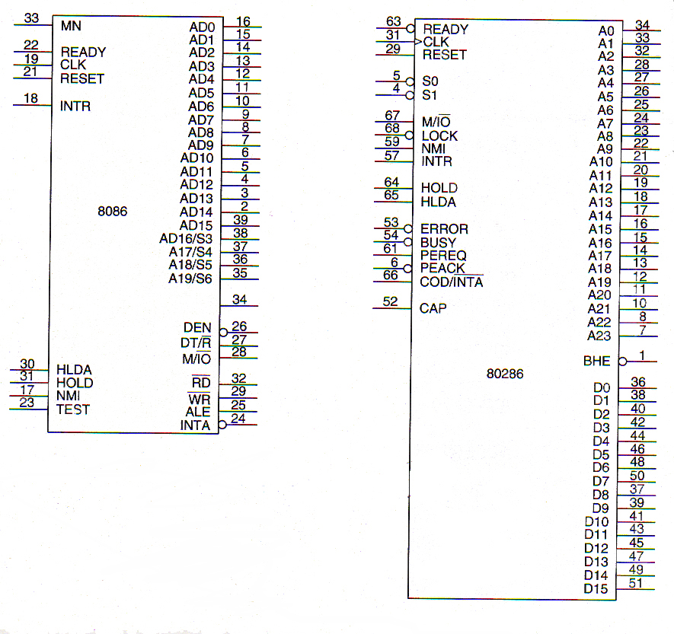

Slide 6
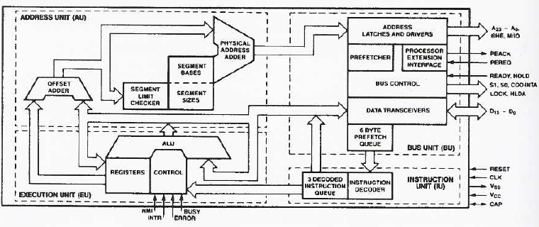
80286 Block Diagram

Slide 7
Address pins A23-A0, /BUSY, CAP, /ERROR, /PEREQ, and /PEACK are new or additional pins that do not appear on the 8086 microprocessor.
The /BUSY, /ERROR. /PEREQ. and /PEACK signals are used with the microprocessor extension or coprocessor e.g. 80287

Slide 8
TEST pin is now referred to as the BUSY pin
The address bus is 24-bits wide to accommodate the 16M bytes of physical memory.
The CAP pin is connected to a 0.047 �F ,+ 20% capacitor that acts as a 12 V filter and connects to ground.
80286 does not contain a multiplexed address/data bus

Slide 9
80286 operates in both the real and protected modes. In the real mode, the 80286 addresses a 1M-byte memory address space and is virtually identical to the 8086. In the protected mode, the 80286 addresses a 16M byte memory space

